Slide 1
Second Choice

Slide 2
Title :KisanYog Team :Second Choice College:Vignan’s Institute Of Information Technology
S.NO | Name | Year of study | Course | Role
1 | G.Yogendra | 3 | CSE | Frontend (Team lead)
2 | Akash Bhandari | 3 | CSE | Backend
3 | Charith | 3 | CSE | Analyser and database

Slide 3
ABSTRACT:
The Idea was triggered from “Farmers-suicides”.The reason for that is majorly because of Lack of financial Support.
So We want to Create a website for that and i.e Kisan Yog.
The project “KISAN yog”is a specialized web-based application that creates an interface for both farmers and Investors .Interactive UI and the ability to manage various Portals makes the system very flexible and convenient.
The development tools used in this project are Html, CSS, JavaScript, MySQL,Asp.net,node,express,mongodb.
This application gives the Admin, the power to manage the entire system from a single online website the system allows the host to Manage all features to the Farmers(accommodation, funds, customized services, and Investors). This helps the Investors to opt on different farms according to his comfort.
.FEATURES:
*Login and Dashboard for (Farmers,Investors,Admin).
*During loss of crop, insurance is given to farmers which is taken while profit (4%)
*Graphs.
*Translator. (Used for better understanding of farmers )
*Approving /Disapproving request by admin.
*Manual Verifiaction by admins.
It provides Machinary,Labour unit and also the prerequisites of farming.

Slide 4
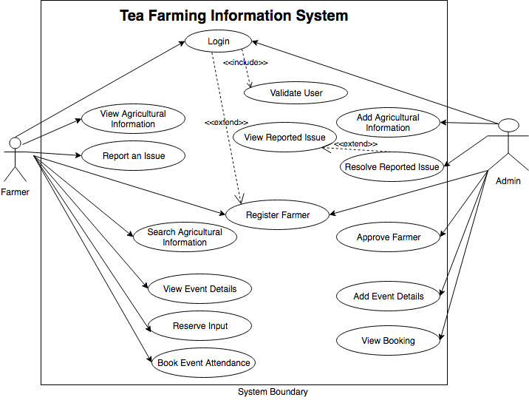
Technology Stack and Use case :
FRONT END:
HTML and CSS.
Java Script.
BACK END:
Php
Express.js
DATA BASE:
My sql
MongoDb

Slide 5
Problem Statement
Problem Statement:
Solution:
• The farmers engage in farming and living in villages do not have affordable technology and proper value of their products due to proper reach to the market. Similarly those who have migrated from the villages but yet they have their parental land in village do not have any setup to manage their land and get due reward of that.
• Key Outcomes ExpectedFor the first category, a tech-based platform which can provide basic machinery, tools; services etc at affordable rates need to be developed.For second category, agriculture management platform is needed to be developed which can have customized solution to non-resident persons to manage their lands.
A website which provides new investing asset in Indian markets for agriculture.-Different investors can invest on different registered farmer's lands. So, both investors and farmers can earn profits.-The farmers will priorly register in our website and can post details of cultivation .-Different investors can invest based upon their interest on particular cultivation. Accordingly.
For non resident person lands will be guided to farmers near them through the admins reach.

Slide 6
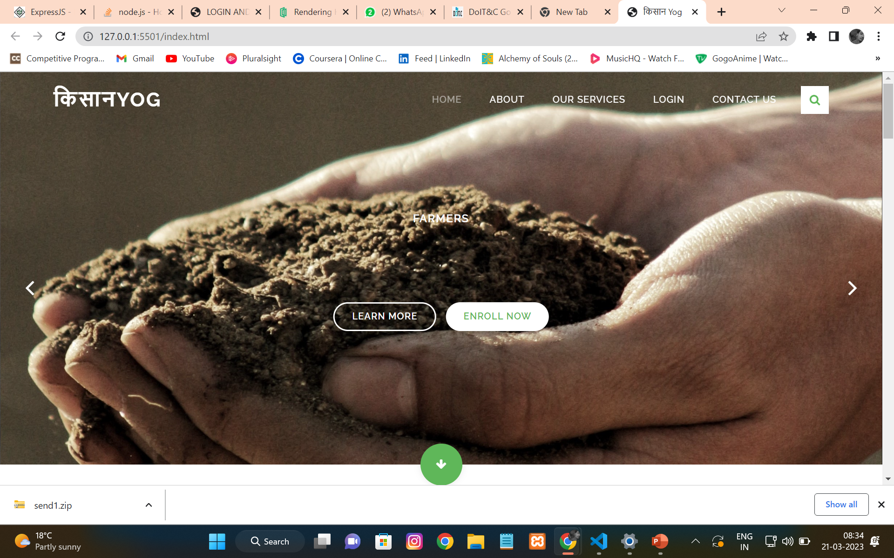
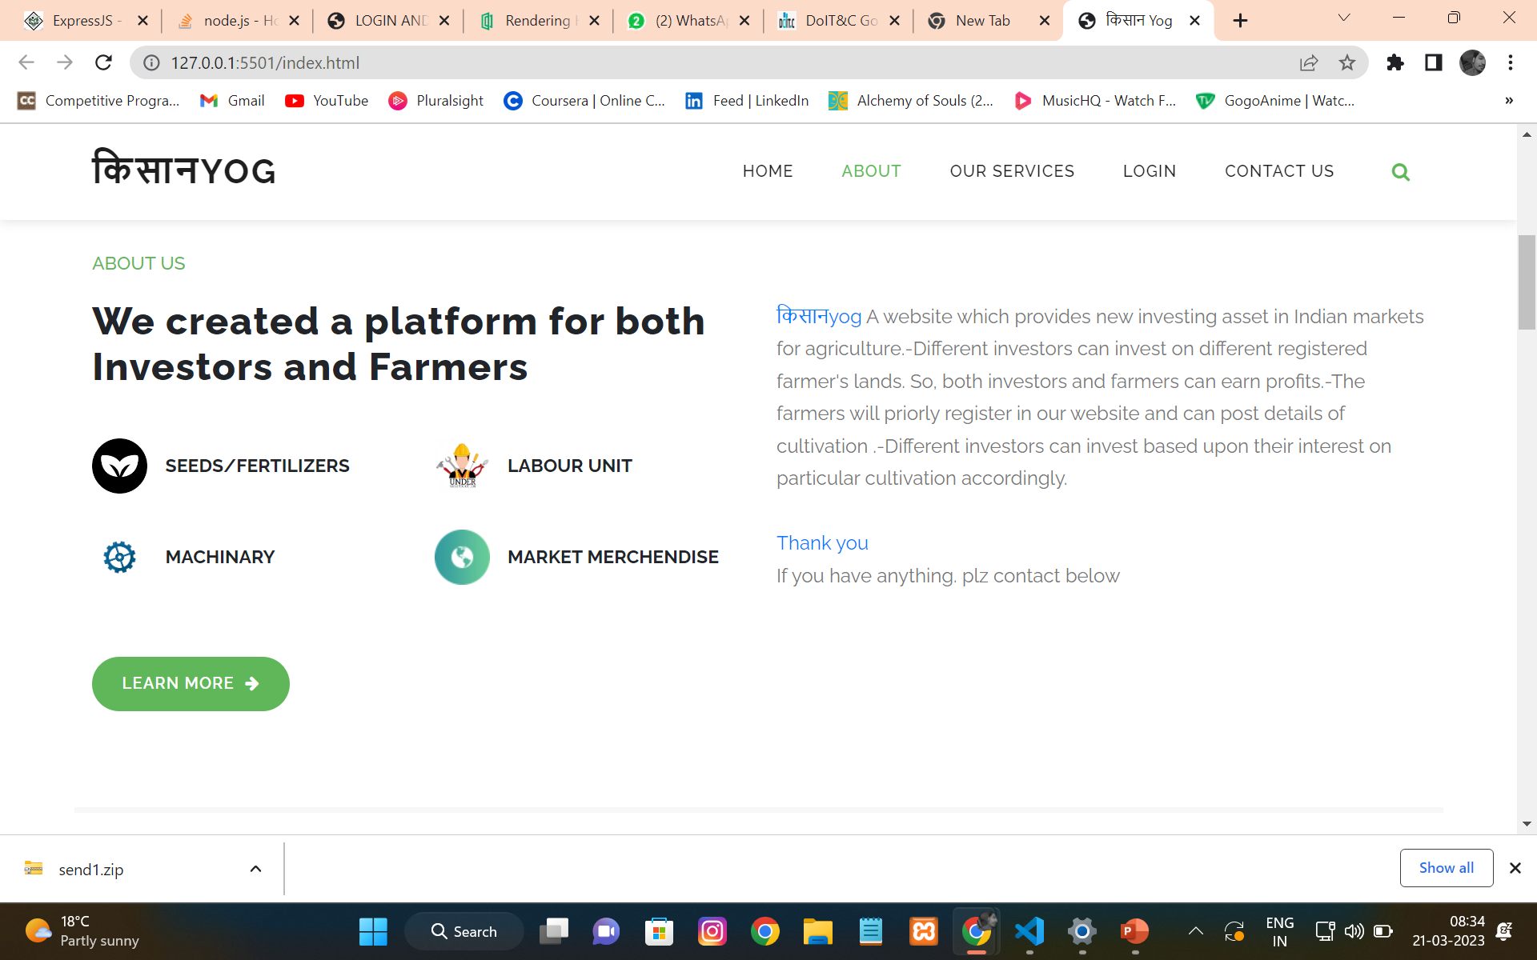
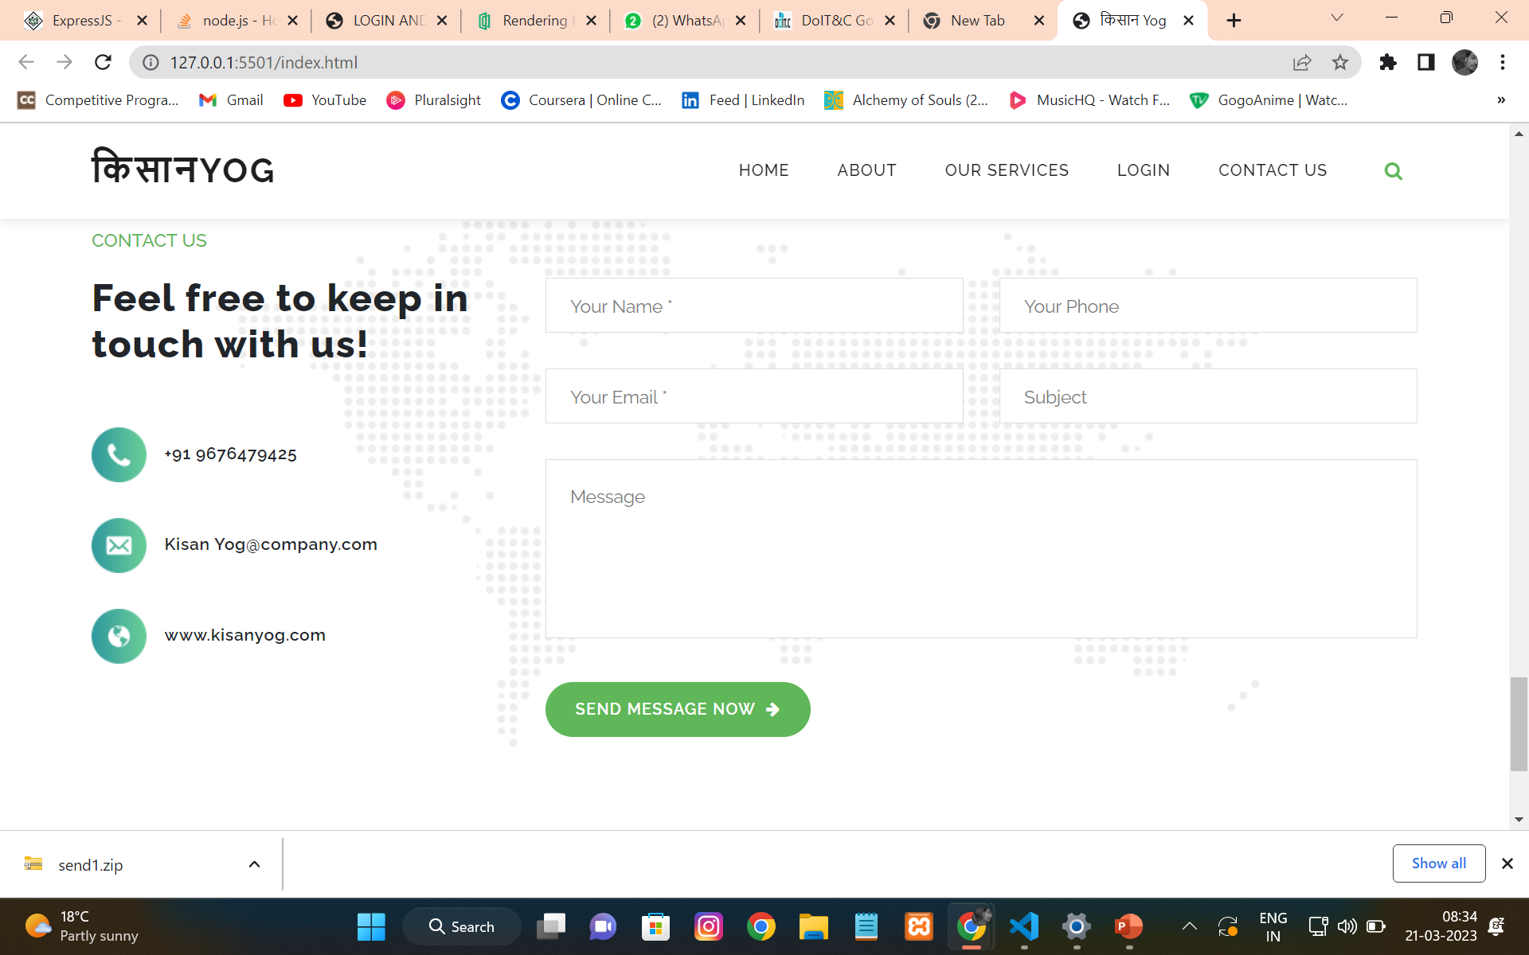
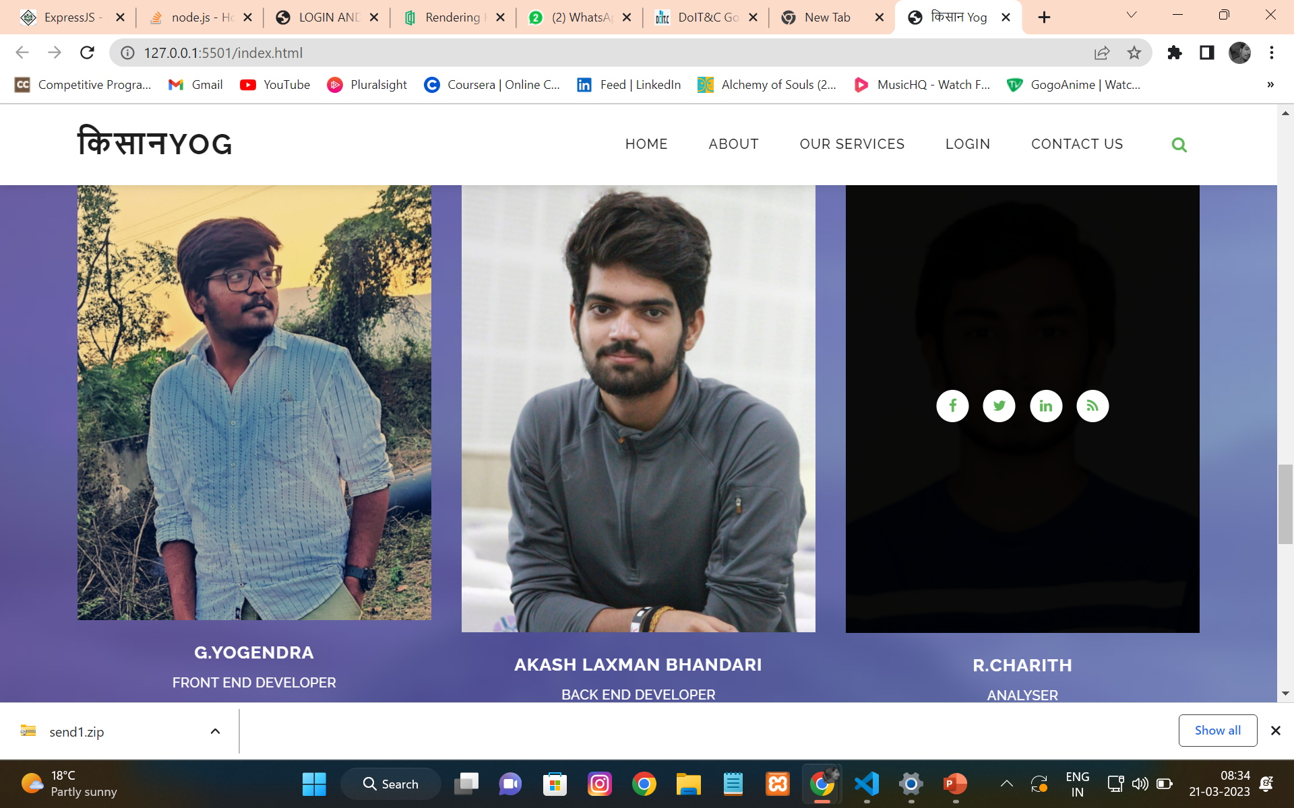
OUTPUTS:
HOME PAGE

Slide 7
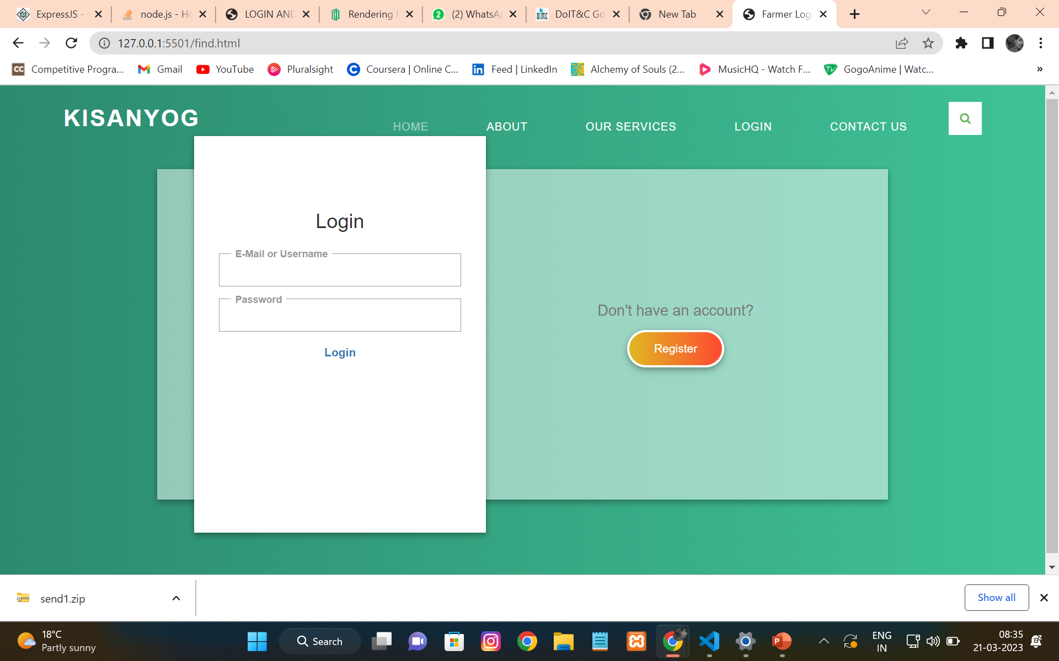
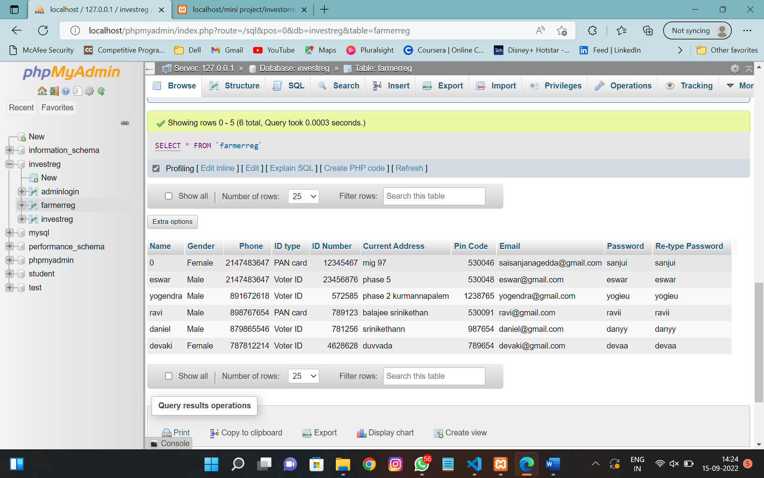
OUTPUT:
Login and regestration
INVESTOR:B-E

Slide 8
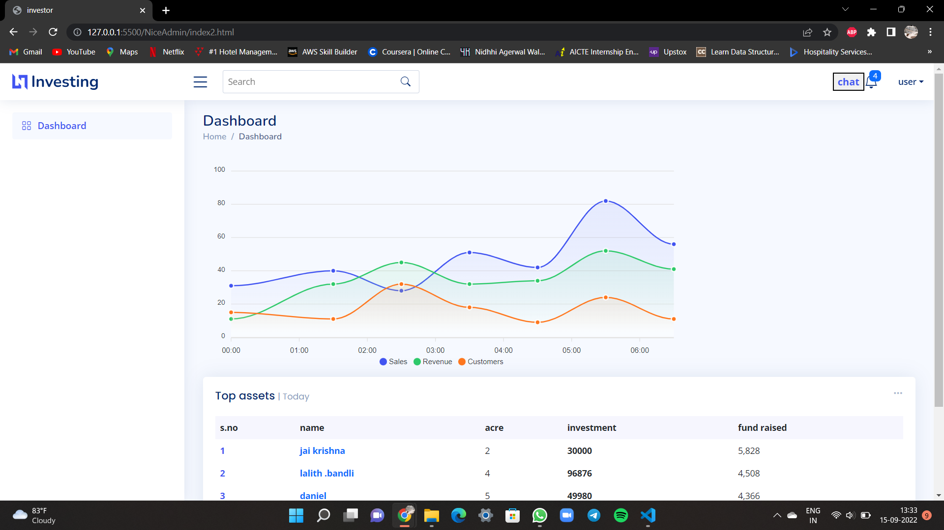
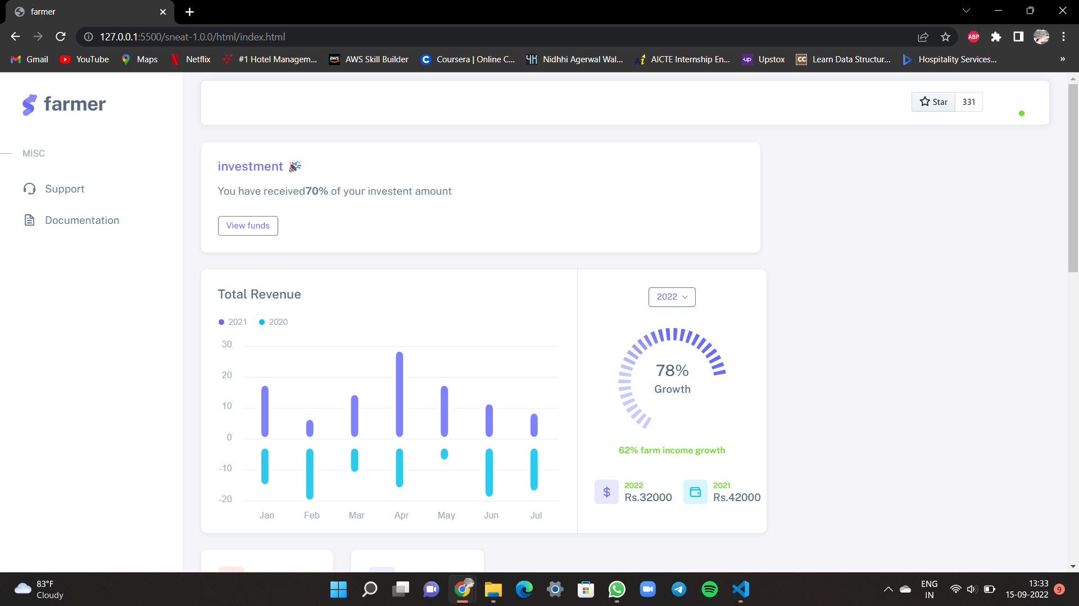
OUTPUT:
INESTOR DASHBOARD:
FARMER DASHBOARD:

Slide 9
THANK YOU .
Second Choice

